Slide 1
Developing the Value Case for Client’s Managed File Transfer (MFT) Platform Modernization Business Value Assessment (BVA) Scoping and Approach
Draft - for discussion only - v1.0
MFT Platform Modernization / Client and IBM Confidential / 2023

Slide 2
Topics
Our Understanding - Purpose and Scope of the BVA
Business Value Assessment (BVA) Overview
Representative Client Examples
Next Steps

Slide 3
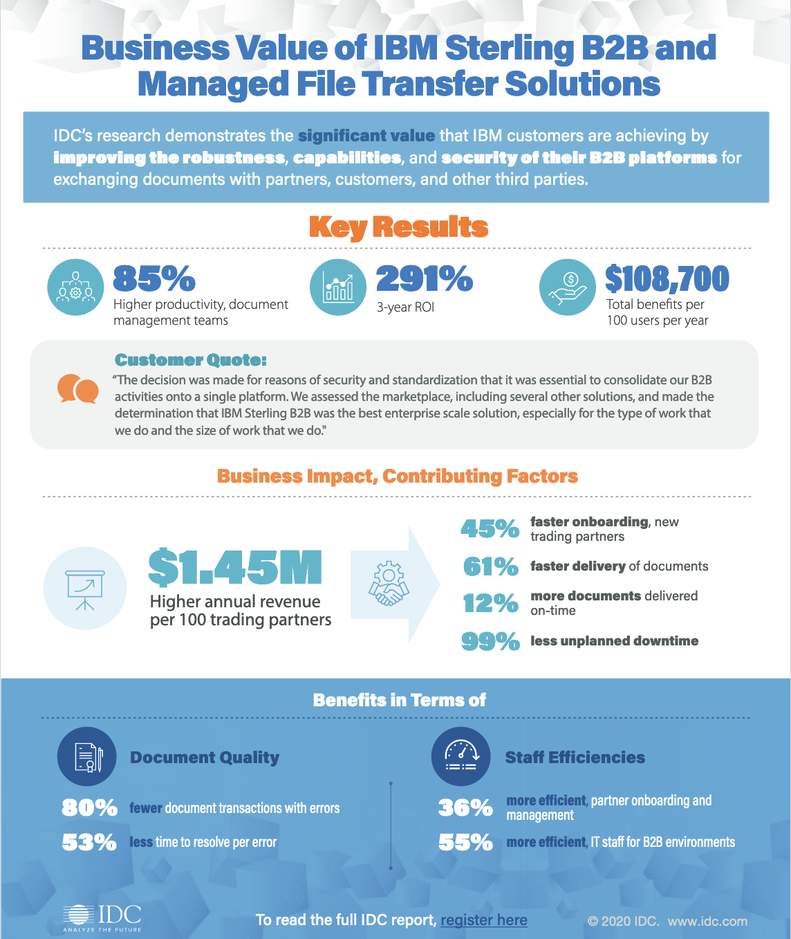
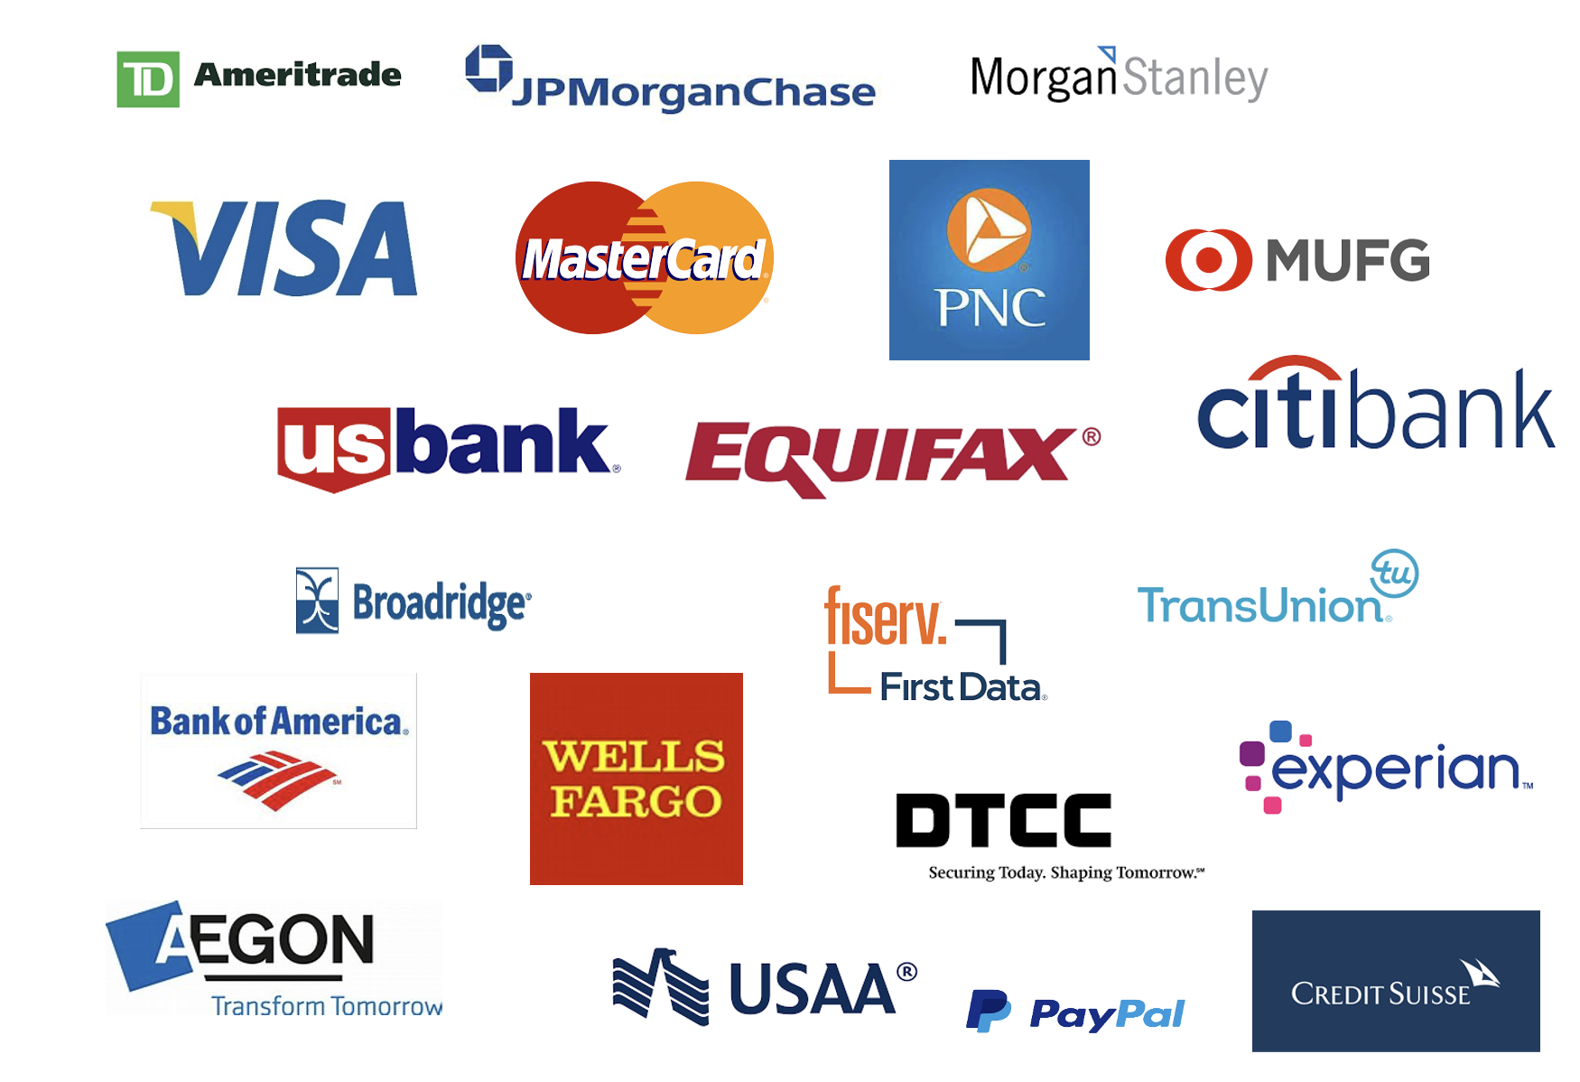
Sampling IBM Sterling Clients - Financial Services 48 of the top 50
IBM Sterling Data Exchange - Value Overview
IBM Sterling Data Exchange solutions offer strong value propositions to IBM’s Financial Services clients
Source: Business Value of IBM MFT Solutions; IDC Business Value Snapshot 2020
MFT Platform Modernization / IBM and Client Confidential / 2023

Slide 4
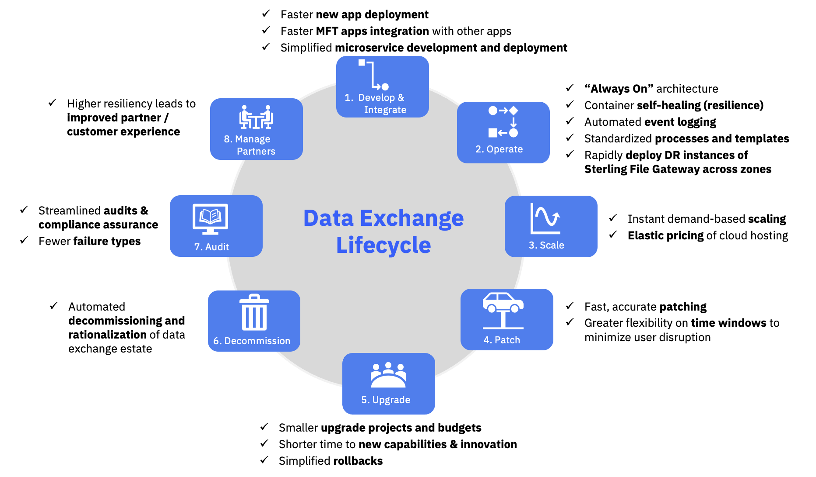
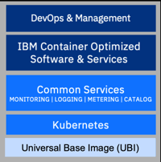
Sterling Data Exchange Containerization
IBM Sterling Data Exchange - Value Overview
Containerizing the Data Exchange footprint delivers benefits across the entire data exchange lifecycle
Data Exchange Lifecycle Benefits
Sterling Certified Containers
Sterling Certified Containers
Enabled for highly optimized containerized deployments with Red Hat OpenShift
Runs On Red Hat OpenShift
SPEED & FLEXIBILITY
Multi cloud / Platform validated
Scalable and Resilient
Simplified deployment management
LOWER COST
Build new integrations using shared infrastructure
Reduced operations and infrastructure costs
Lifecycle managed / upgradable
LOWER RISK & OPEN STANDARDS
Security, logging, monitoring
Governed for best practices
Amplify core capabilities at scale
RHOS
MFT Platform Modernization / IBM and Client Confidential / 2023

Slide 5


IBM Sterling Data Exchange Business Value Assessment (BVA) Overview
Business Value Assessment (BVA) Overview
Goal
Key Objectives & Scope
Help Client develop a compelling business case and planning roadmap to improve data exchange capabilities with IBM Sterling Data Exchange solutions
Primary objectives: e.g., Platform Modernization, Trading Partner Automation, End-to-End Visibility,
Primary organizational scope: <list>
Primary data exchange processes: <list>
Deliverables
Initial Scope
Reason Why
Alignment with strategic objectives and project funding rationale
Key Benefits
Key financial and operational benefits (e.g., lower platform TCO, increase DevOps productivity, avoid line of business cost, reduce business risk)
Solution Alignment
Required solution enablers and key new capabilities (“day in the life”)
Implementation Planning Roadmap & Cost
Phased solution roll-out plan (e.g., crawl - walk - run) and estimated cost
ROI Bottom Line
Multi-year ROI, payback, and cash-flow dynamics; capex/opex requirements
5

Slide 6
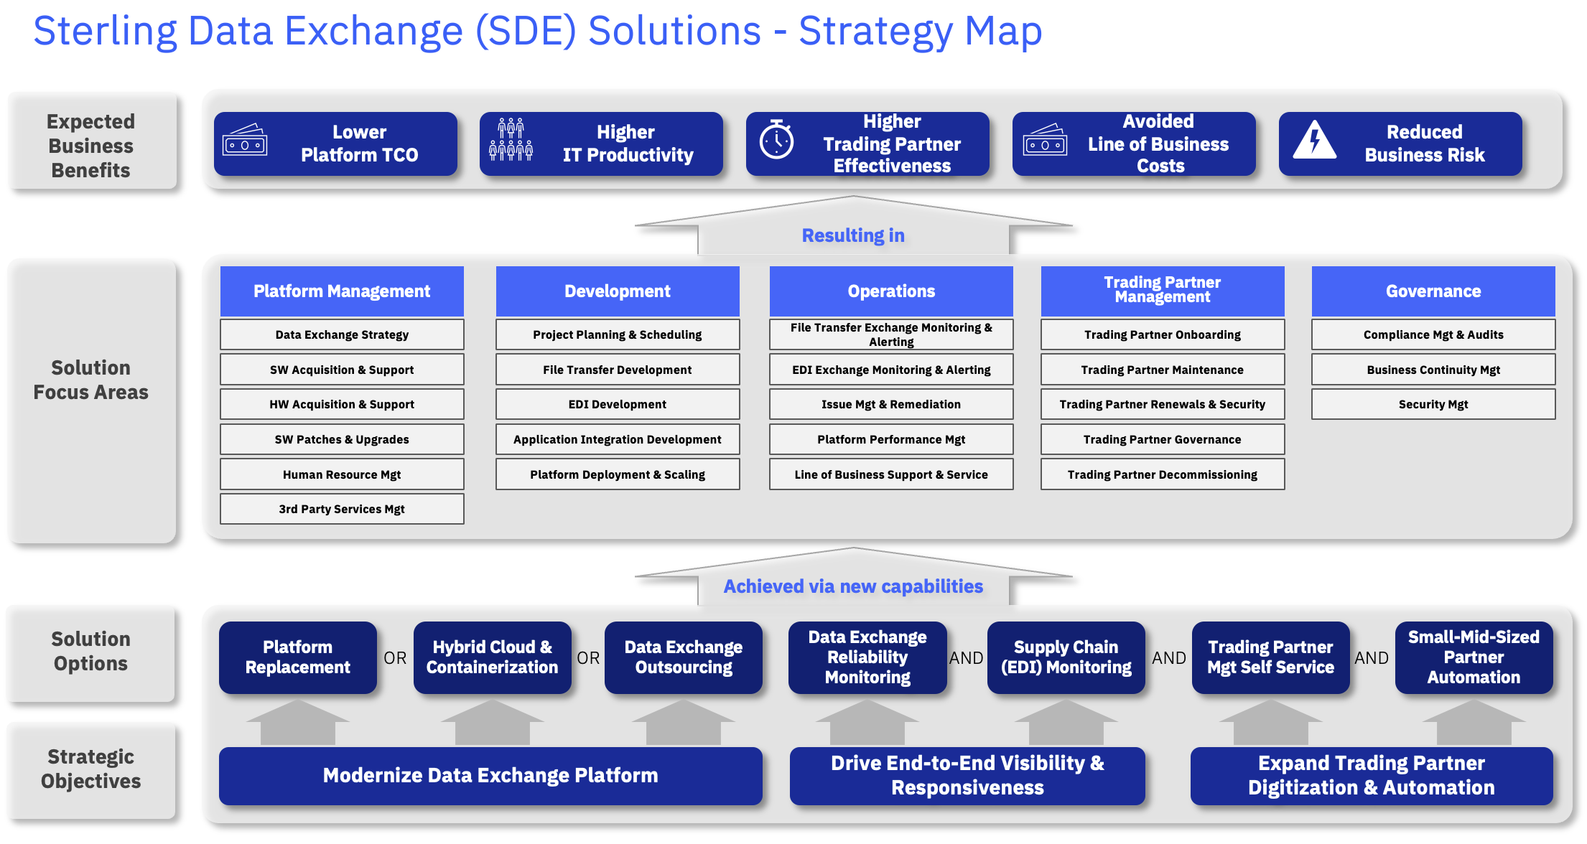
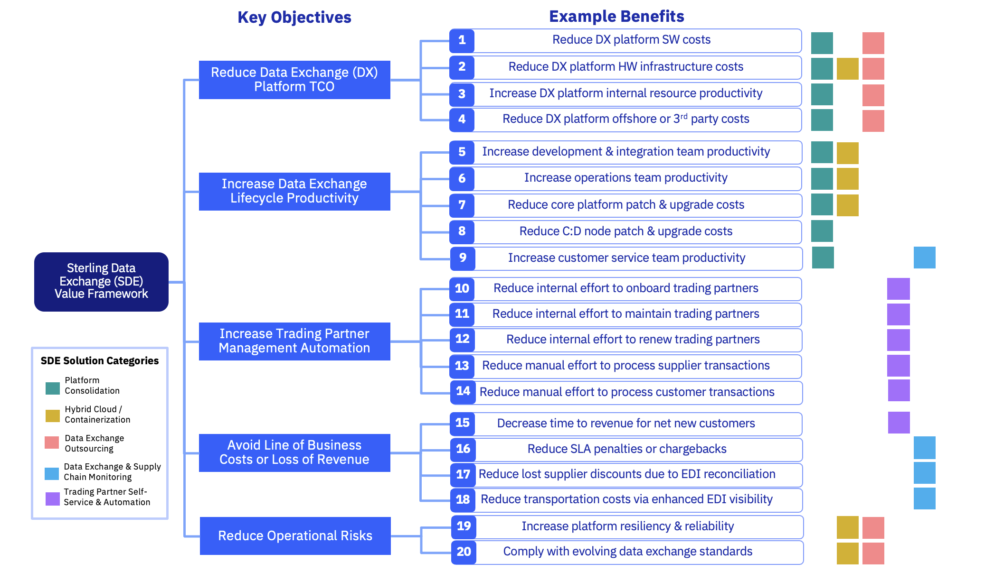
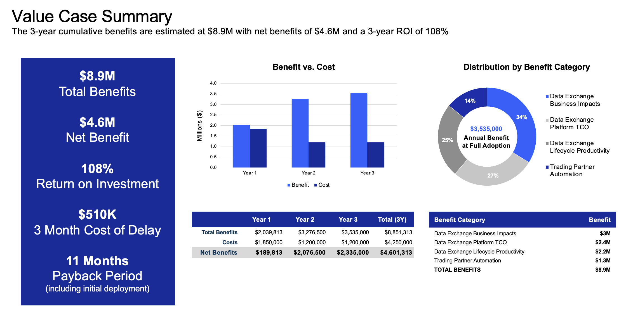
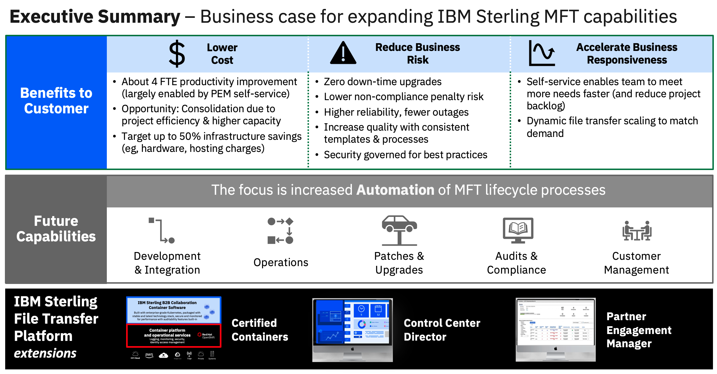
BVA for Sterling Data Exchange - Approach
Business Value Assessment (BVA) Overview
Collaborative process to strengthen the business case and stakeholder buy-in for the initiative
Targeted and proven approach that leverages insights from operations and financial subject matter experts and stakeholders while minimizing their time commitment
Elapsed timeline is approximately two weeks, with initial 2-3 interviews, interim checkpoints, and socialization of final deliverable
Assessment Scoping – ½ hour
Discovery Interviews – 1 hour per
Synthesis and Value Model – 1 week
Value Case Readout – 1 hour
Step 1
Discover and gain consensus on key improvement areas
Step 2
Define benefit opportunities and value propositions
Step 3
Establish business case modeling framework
Step 4
Summarize and present strategic business opportunities and value case
1) The approach is flexible and can be customized to the client-specific situation and scope

Slide 7
Client Example 1: Financial Services
Representative Client Examples
Sterling Data Exchange Value Framework with Prioritized Benefit Opportunities for <Client X>
Benefit Categories
Prioritized Benefits¹
Benefit Assumptions
Annual Benefit Potential
$950k
Reduce incumbent MFT platform SW costs
$800k/yr [annualized MFT platform SW cost]
$800k
Reduce Incumbent MFT Platform TCO
1
Reduce incumbent MFT platform 3rd party services cost
2
$150k/yr [annualized 3rd party MFT platform services cost]
$150k
Increase development & integration team productivity
6 FTEs [Development] x $100k [Annual Loaded Rate] x 35% [Productivity Improvement]
$210k
$870k (~9 FTEs)
3
Increase operations team productivity
14 FTEs [Operations] x $100k [Annual Loaded Rate] x 20% [Productivity Improvement]
$280k
Increase Data Exchange Lifecycle Productivity
4
$3,535K
Reduce core platform maintenance & upgrade costs
$160k
5
4 FTEs [Maintenance] x $100k [Annual Loaded Rate] x 40% [Productivity Improvement]
Sterling Data Exchange (SDE) Value Framework
Increase customer support/service team productivity
$220k
6
11 FTEs [Support] x $100k [Annual Loaded Rate] x 20% [Productivity Improvement]
$500k (5 FTEs)
Reduce cost to onboard new trading partners
2 FTEs [Onboard] x $100k [Annual Loaded Rate] x 50% [Productivity Improvement]
$100k
7
Increase Trading Partner Management Automation
8
$200k
Reduce cost to maintain existing trading partners
4 FTEs [Maintain] x $100k [Annual Loaded Rate] x 50% [Productivity Improvement]
9
Reduce cost to renew existing trading partners
2 FTEs [Renew] x $100k [Annual Loaded Rate] x 50% [Productivity Improvement]
$100k
10
$1,215k
Reduce cost to manage trading partner transactions
2 FTEs [Manage] x $100k [Annual Loaded Rate] x 50% [Productivity Improvement]
$100k
Accelerate Time to Value for New Trading Partners
11
Accelerate time to revenue for new trading partners
1,350 TPs [Onboard New] x $450 [Income Contribution/Day] x 2 days [Avg faster onboarding]
$1,215k
TOTAL: $3,535K
Benefit prioritization subject to review and validation with <Client X>
Current state baseline assumptions subject to review and validation with <Client X>; benefit improvement potential based on IDC study and IBM experience with other clients
Annual benefit potential at steady state run-rate with new MFT platform fully deployed
IBM Sterling Data Exchange / <Client X> MFT Platform Modernization / Initial Value Perspective

Slide 8
Client Example 2: Financial Services
Representative Client Examples
Data Exchange Platform Modernization & Trading Partner Automation - Business Case Summary
$9M
Total Benefits
$4.8M
Net Benefit
112%
Return on Investment
$510K
3 Month Cost of Delay
11 Months
Payback Period
(including initial deployment)
Millions ($)
$3,656,500
Annual Benefit at Full Adoption
 | Year 1 | Year 2 | Year 3 | Total (3Y)
Total Benefits | $2,039,813 | $3,331,175 | $3,656,500 | $9,027,488
Costs | $1,850,000 | $1,200,000 | $1,200,000 | $4,250,000
Net Benefits | $189,813 | $2,131,175 | $2,456,500 | $4,777,488
Benefit Category | Benefit
x
Data Exchange Business Impacts | $3.2M
x
Data Exchange Platform TCO | $2.4M
x
Data Exchange Lifecycle Productivity | $2.2M
x
Trading Partner Automation | $1.3M
x
TOTAL BENEFITS | $9M
IBM Sterling Data Exchange / <Client X> MFT Platform Modernization

Slide 9

Next Steps
Next Steps
Finalize the assessment scope e.g., objective(s), organization(s), process(es)
Identify the key stakeholder(s) and subject matter expert(s) to schedule short interviews
Schedule Discovery Workshop/Interviews (potentially including site visit)
Gather financial and operational data inputs
Agree on a timeframe for the interviews, workshops, and the business case socialization

